Slide 1
Programming Presentation
By: Bandr AlSwyan

Slide 2
Buffer Overflows Attack
From my essay:
Introduction: A buffer overflow occurs when a programmer writes more data in memory that exceeds its space that is allocated in a given program.
A program's memory is divided into different segments, including stack, heap, and buffer.
The buffer is the memory storage region that holds a program's data as it is transferred to another location.
The buffer overruns occur when a given program attempts to fill a buffer with more data that was not designed to hold.

Slide 3
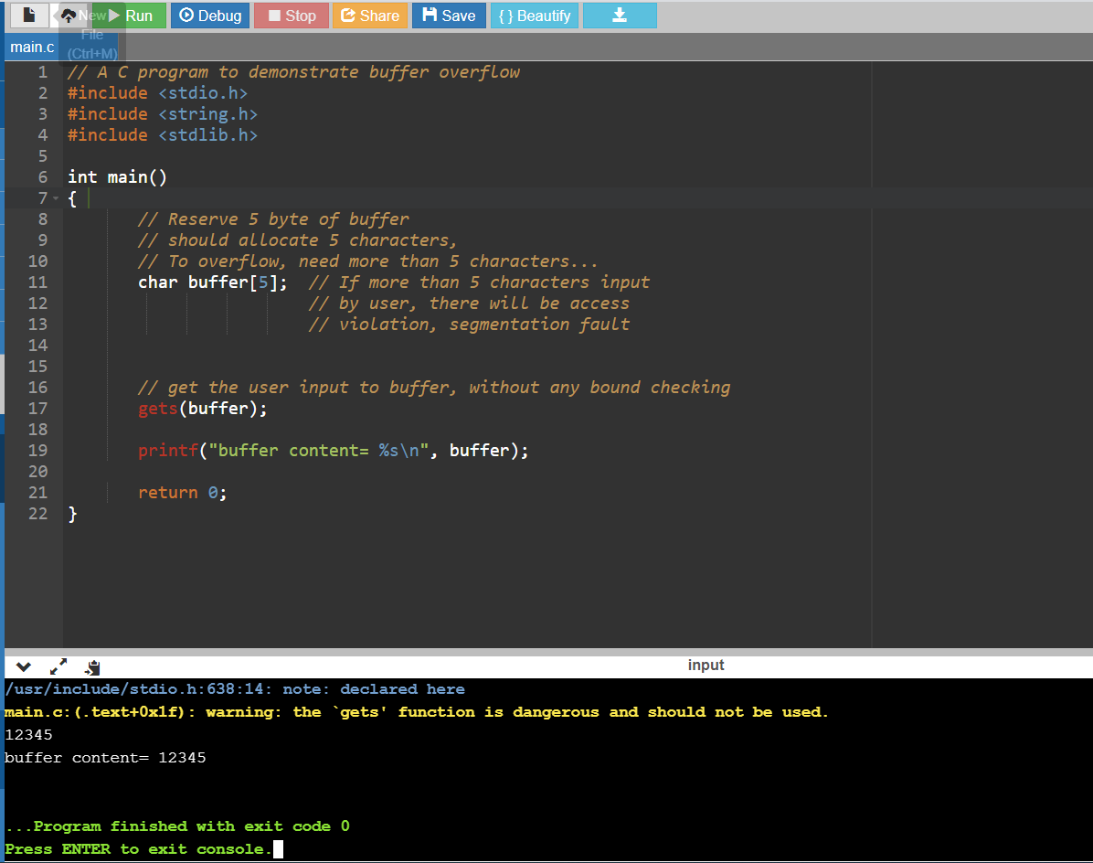
Buffer Overflows Attack Simulation
We used the below C code for showing the buffer overflow attack. We used “gets” method to get the input from the user by console. As you see in the first run of the program in the first image, we entered “12345” as the input and because its size is less than or equal to buffer size, this code runs successfully.

Slide 4
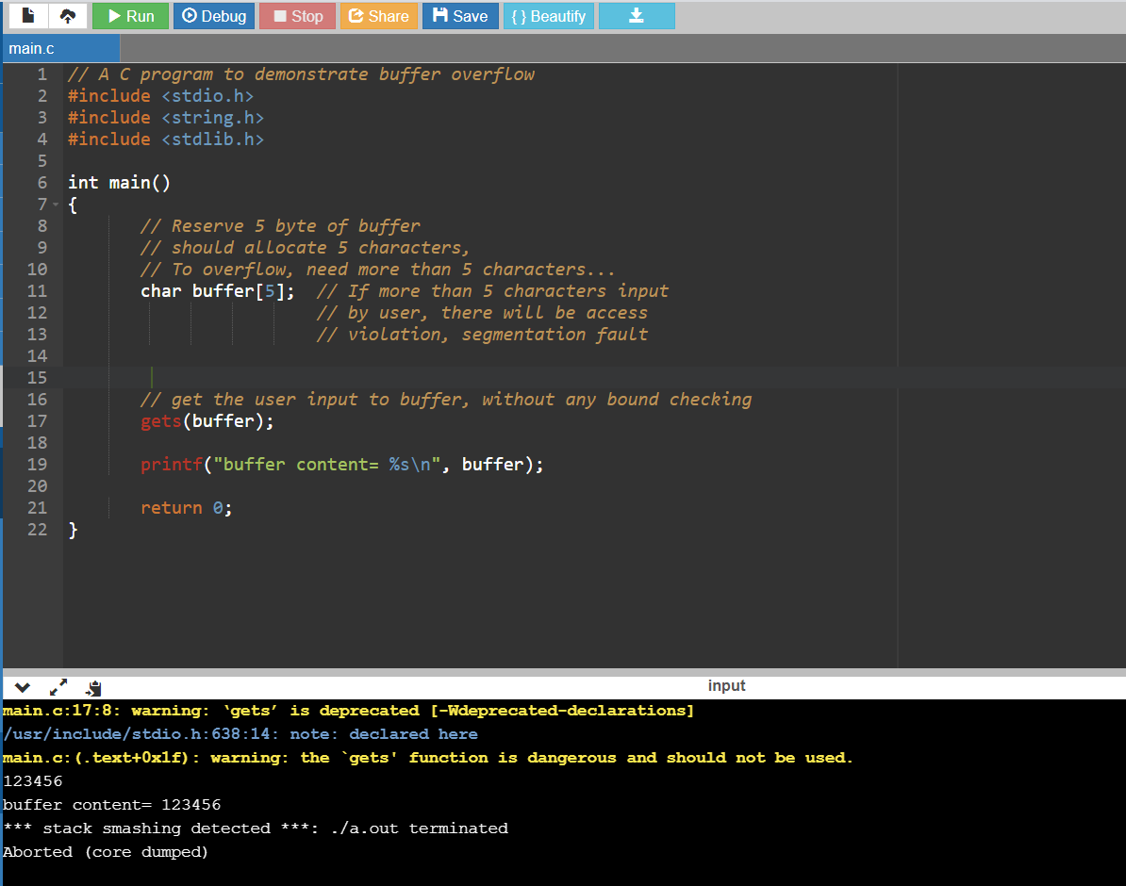
Buffer Overflows Attack Simulation
In the second run, we entered a larger input. It is larger than the size of the buffer and as we see, it goes to the Stack Smashing Error. It means that we allocate characters more than buffer size and compiler prevent doing this by this error. As you see the compiler aborted the program and doesn’t let the other lines to run and the next lines (like printf) never runs in this scenario.

Slide 5
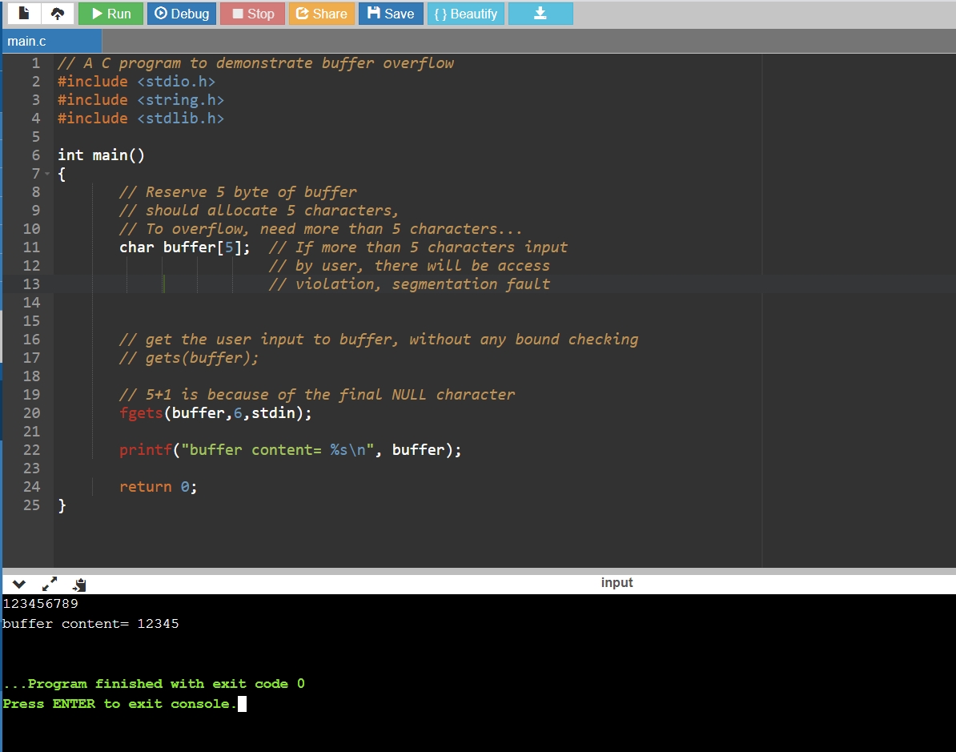
Buffer Overflows Attack Simulation
So, what is the solution? For solving this problem different programming languages provide some secure methods which strongly recommended. For example, we can use fgets instead of gets. By calling fgets we pass the appropriate size of the input and if the entered input was larger than that, it will cut it and use only the first matched part. You can see this process in the following code:

Slide 6
Buffer Overflows Attack Simulation
Below is the list of such functions and, if they exist, their safe equivalents:
gets() -> fgets() - read characters
strcpy() -> strncpy() - copy content of the buffer
strcat() -> strncat() - buffer concatenation
sprintf() -> snprintf() - fill buffer with data of different types
(f)scanf() - read from STDIN
getwd() - return working directory
realpath() - return absolute (full) path

Slide 7
Cross-Site Scripting Attack
From my essay:
Introduction: Cross-Site Scripting (XSS) is a website attack where malicious codes get injected into existing websites.
This type of cyber-attack is also known as a client-side code injection attack.
In the event of an XSS occurrence, the attacker sends malicious codes and scripts to the user's website. The method aims to run and execute the codes on the end user's device
The process utilizes unvalidated inputs to change the outputs from the unsuspecting user. The common avenues where XSS attacks occur include message boards, forums, and web pages that permit comments

Slide 8
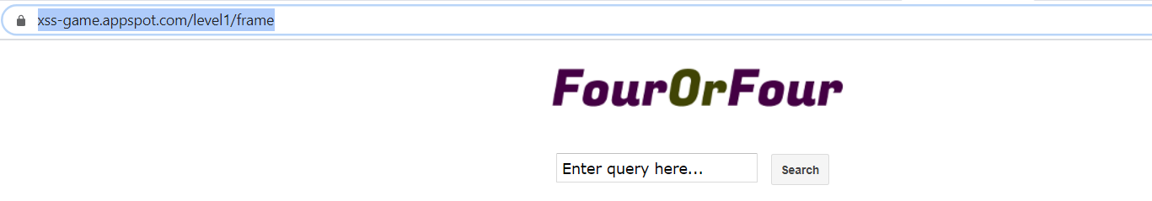
Cross-Site Scripting Attack Simulation
In this task we ask user to enter a query in our python code. The query will pass to this website: https://xss-game.appspot.com/level1/frame

Slide 9
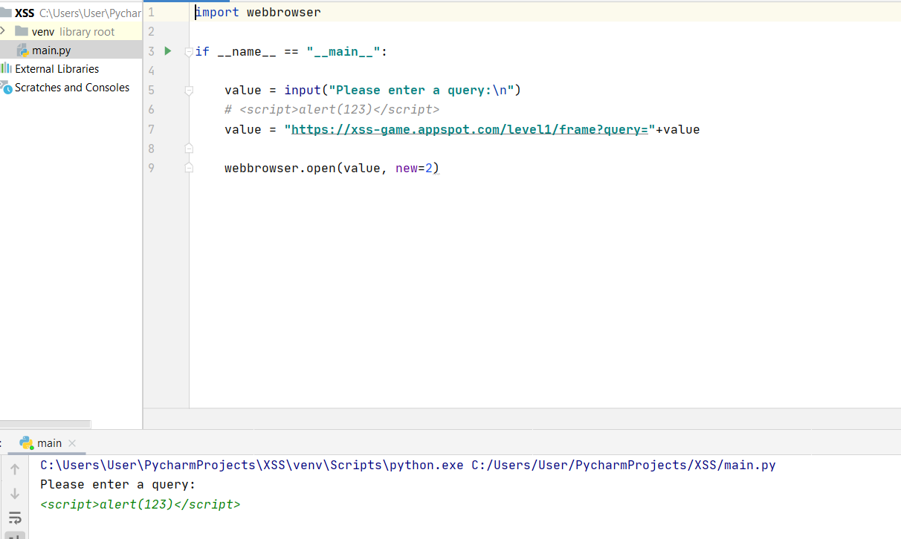
Cross-Site Scripting Attack Simulation
Every input in our python code will pass to this website and placed inside the input box. The problem is that user can add a script in the input box and instead of running a query, running a code in our website and attack to the private information like cookies.
As you see in the below image, we run the python code and pass a simple script into it: <script>alert(123)</script>
Python code pass this to the website and website thinks this is a simple search query and run it. But by running this code the script will run in the system and do what we want in the website.

Slide 10
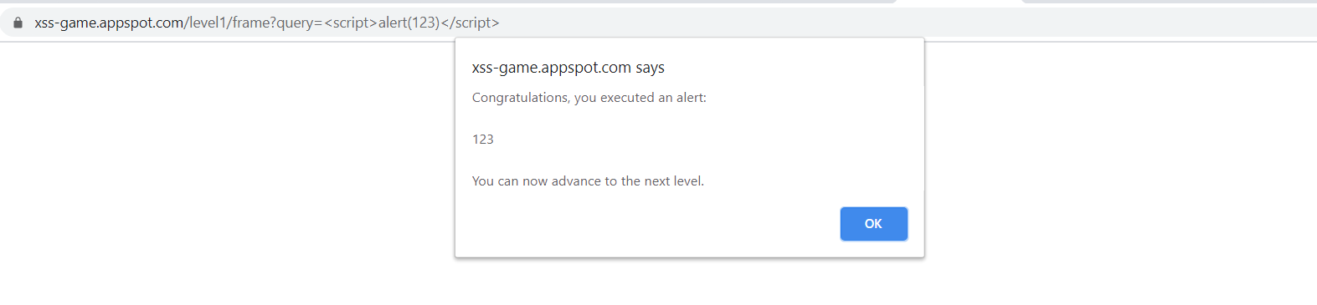
Cross-Site Scripting Attack Simulation
As you see in below image, the website will show the alert box with our message (“123”).

Slide 11
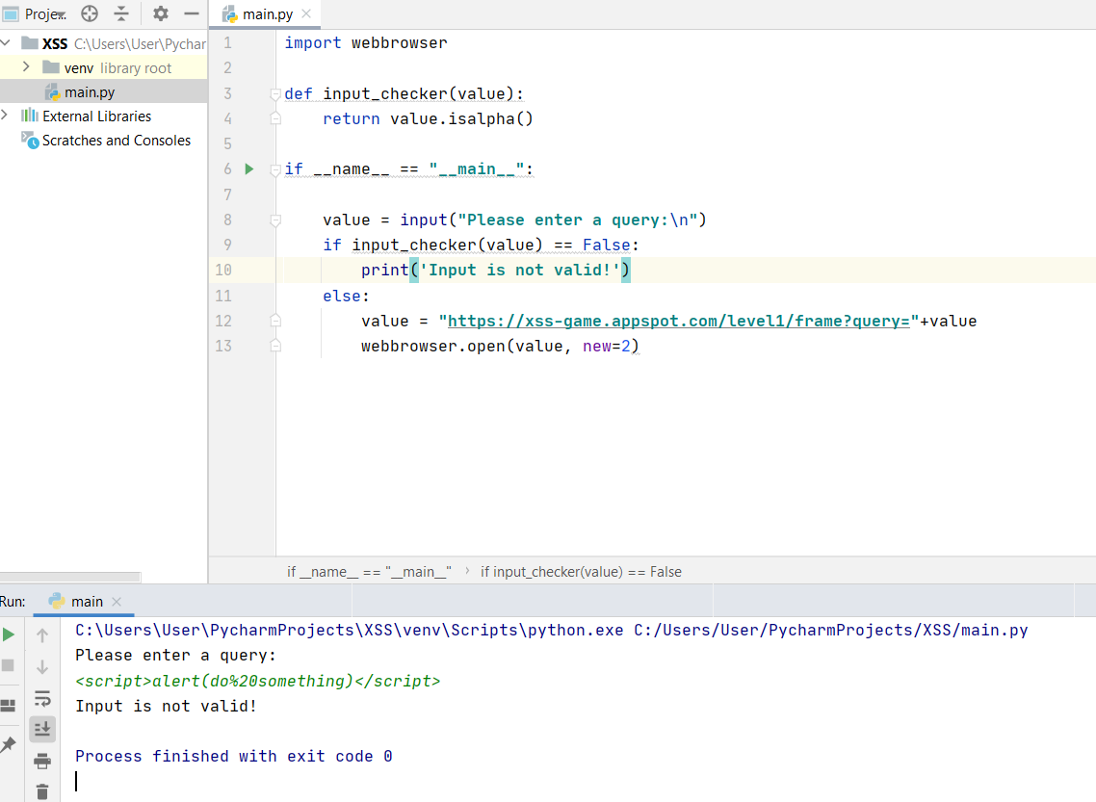
Cross-Site Scripting Attack Simulation
There are two things to correct this attack:
1- Input validation: We need to decide which character set is valid for the input box and restrict the inputs, for example we can restrict the input data to only the uppercase and lowercase letters.

Slide 12
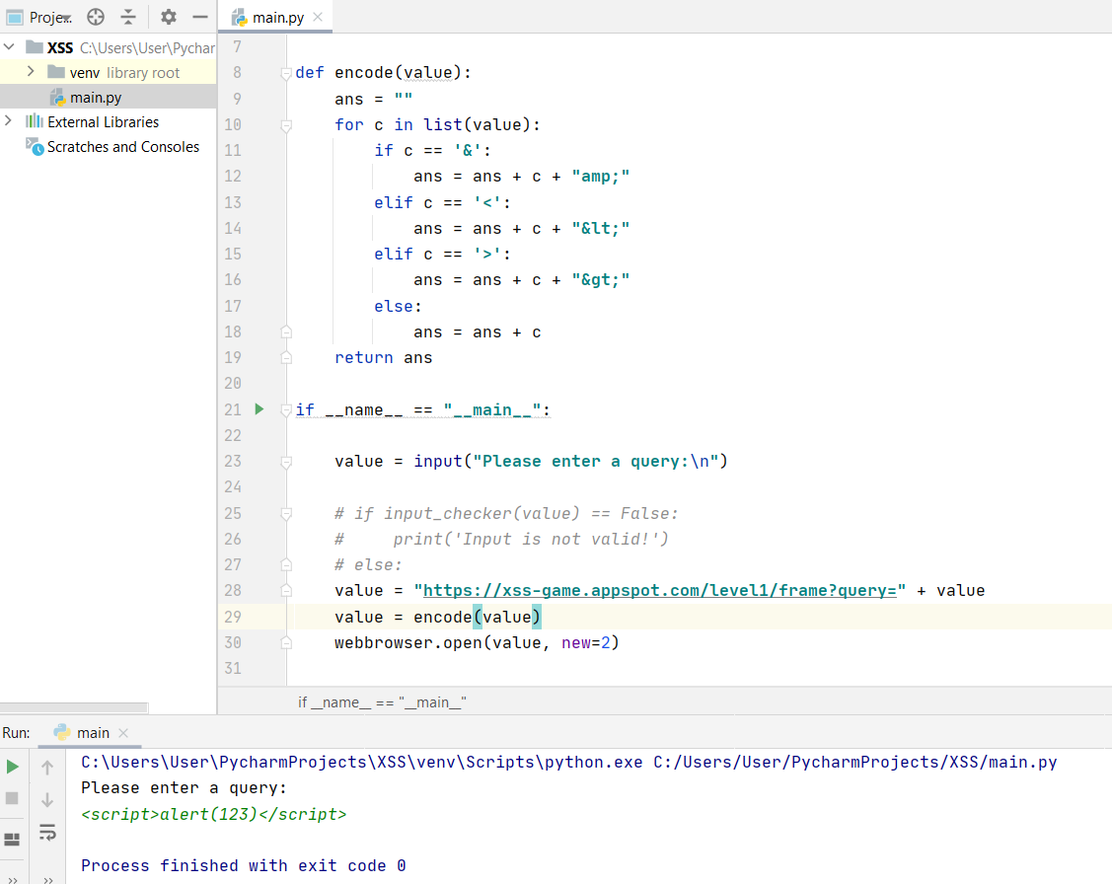
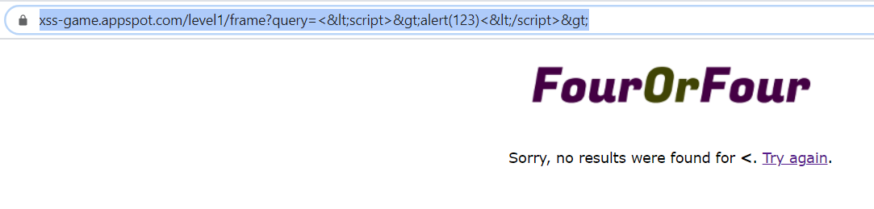
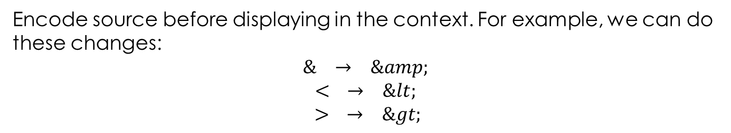
Cross-Site Scripting Attack Simulation
Encode source before displaying in the context. For example, we can do these changes: $$\& → \&amp;$$
$$< → \&lt;$$
$$> → \&gt;$$
As you see in the images next, we do the encoding and by running the program with previous input we will not see the alert and we will only have a simple search even by receiving a script as input. The result are below:

Slide 13
SQL Injection Attack
From my essay:
Introduction: The SQL Injection attack depends on malicious SQL code for accessing data, which was not previously intended for display.
The attack occur with the help of backend database manipulation, and the information displayed may include sensitive company information, including the lists of private customers and their personal data.
The attackers insert arbitrary SQL into their chosen companies databases to either delete, modify, or copy database content.

Slide 14
SQL Injection Attack Simulation
SQL injection is a code injection technique, used to attack data-driven applications, in which malicious SQL statements are inserted into an entry field for execution. As an example of this type of attack we can take a look at the following example.
If we have the following code for handling email and password for login: SELECT * FROM users WHERE email = 'user@email.com' AND pass = 'password' LIMIT 1

Slide 15
SQL Injection Attack Simulation
If system does not check the password, we can enter following password as the password of any email address:
' or 1=1—
If you replace password with the above, we will have:
SELECT * FROM users WHERE email = 'user@email.com' AND pass = '' or 1=1--' LIMIT 1
And by running this code by sql you can easily break the password without having to guess the password.

Slide 16
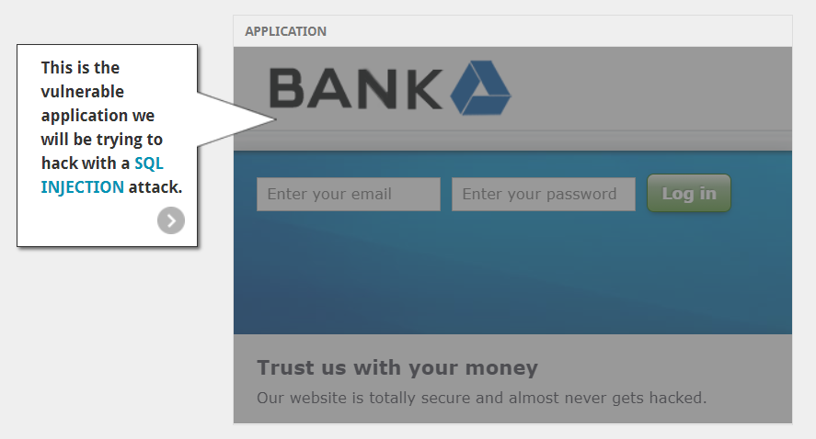
SQL Injection Attack Simulation
You can see the implementation here: https://www.hacksplaining.com/exercises/sql-injection

Slide 17
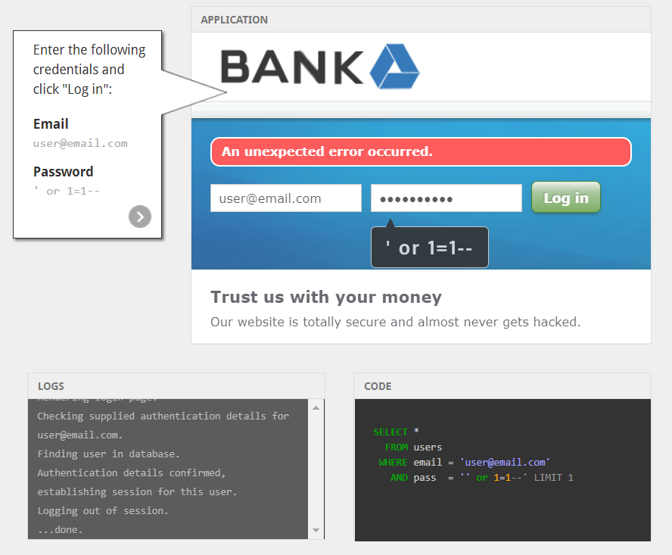
SQL Injection Attack Simulation

Slide 18
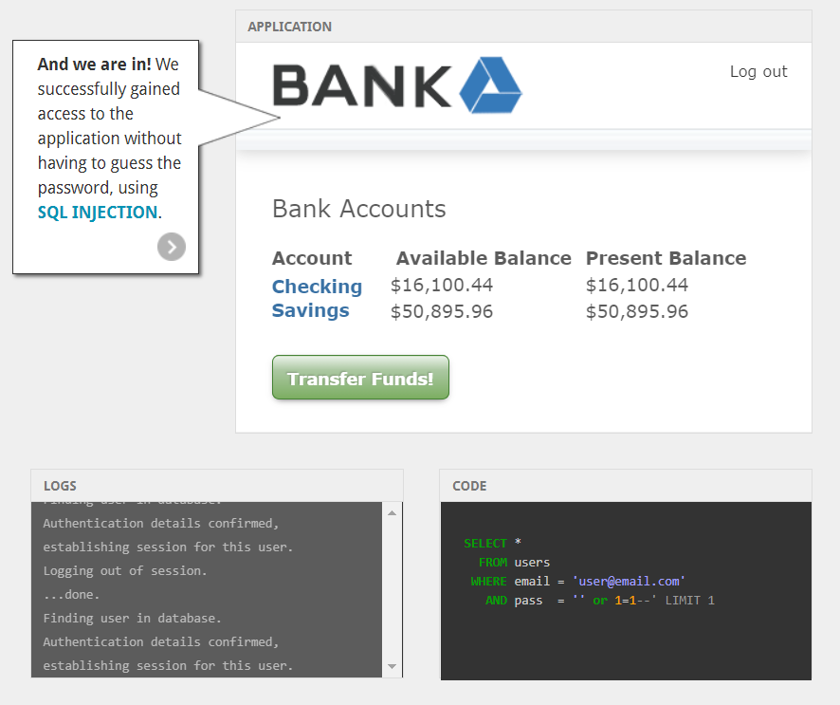
SQL Injection Attack Simulation

Slide 19
Thank you

